Slide 1
Welcome to Year 1

Slide 2


Welcome to Year 1 at Thameside Primary School
We would like to welcome you to Year One at Thameside Primary School. We are ready to help you and your child embark upon the next part of their learning journey.
At Thameside, we aim to ensure that everyday is full of purposeful learning driven by an exciting and creative curriculum.

Slide 3
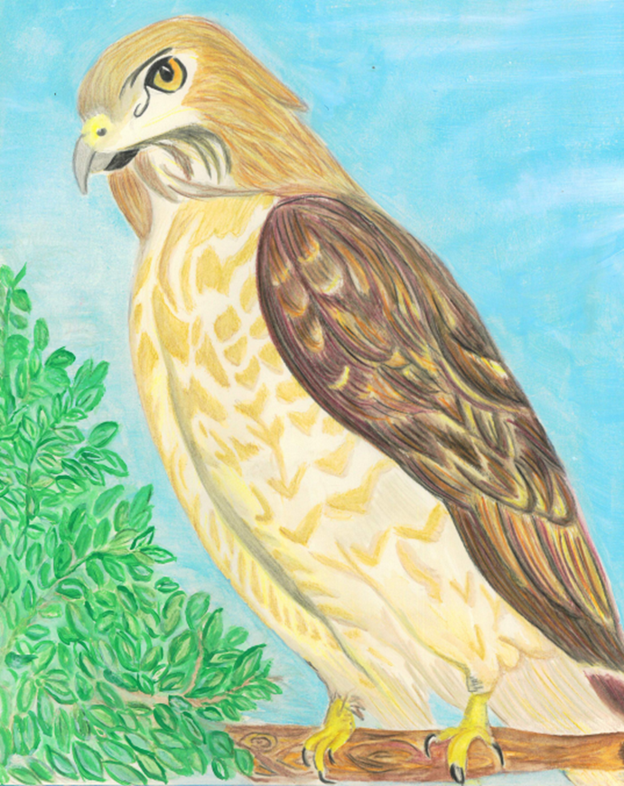
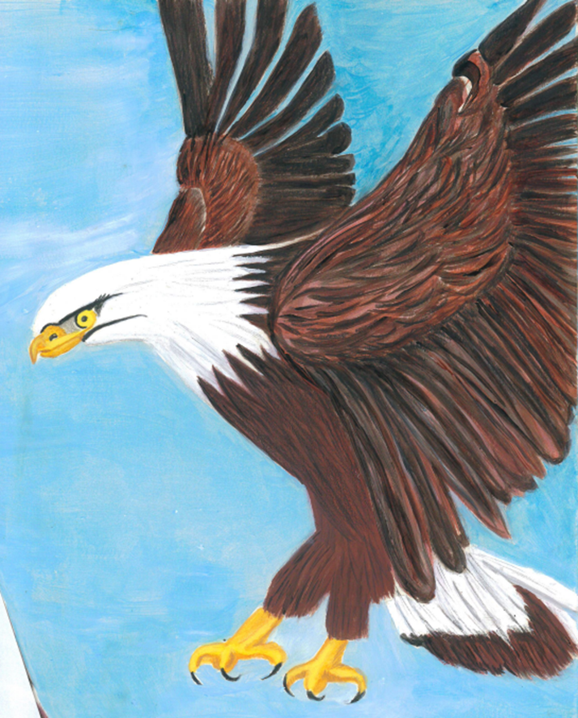
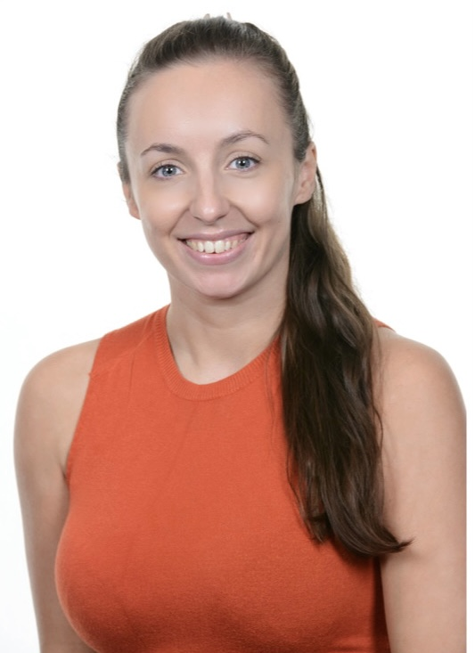
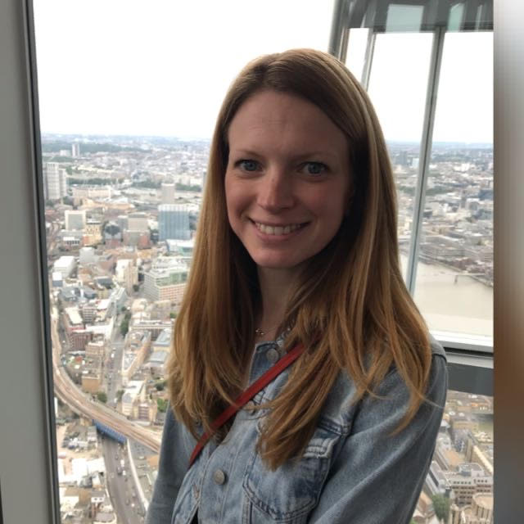
Teachers in Year 1
Hawks Class
Miss Padley
Eagle Class
Mrs Bickerton

Slide 4
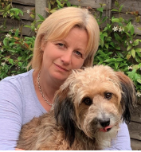
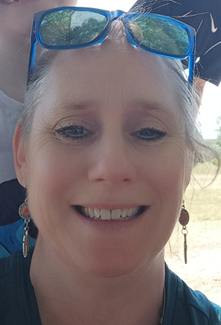
These adults will be supporting in Year 1:
Mrs Browne | Mrs Grace

Slide 5
Learning in Year 1
Reading Skills
Developing fluency Use phonic knowledge Retelling key events Discussing word meanings Making inferences based on what is said and done
Writing Skills
Planning what to write and ‘holding a sentence’ Write a sentence Use capital letter, full stops correctly Spacing and letter size is correct
Maths
Number skills Number bonds Shape,space and number
Wider Curriculum
Autumn | Spring | Summer
Great Fire of London Mugumarono Village, Zambia Printing Christmas Production | Florence Nightingale and Mary Seacole Continents and Oceans Making cars Sculpture | Seaside: Now and then Beach Trip Bridges Sports Day

Slide 6
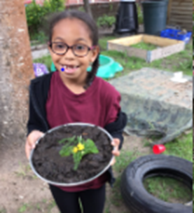
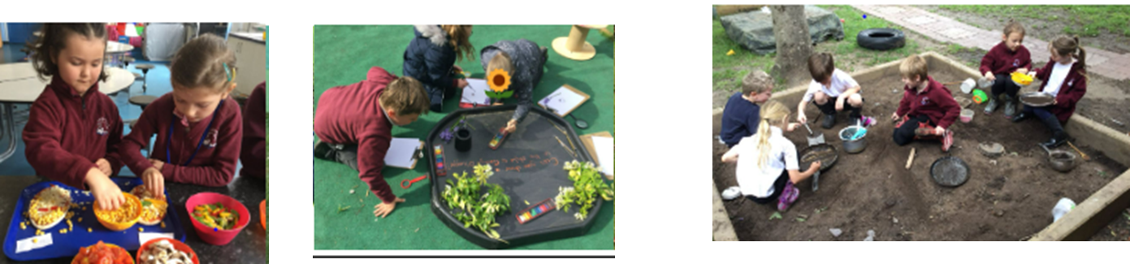
Continuous Provision in Year 1
As your child moves into Year 1 they will continue to learn through play and exploration. These play-based experiences enable the children to consolidate their skills, knowledge and understanding and enable them to be become independent and resilient learners. Throughout the environment, you will see busy children actively engaged in a wide range of activities that they themselves have chosen. Continuous provision supports and encourages our children to have a lifelong love of learning.
To find out more about continuous provision follow this link Continuous Provision in Year 1 - Thameside Primary School

Slide 7
The school day
A typical school day:
School gates open at 8.40am
Gates close at 8.50am and the register is taken. Children arriving after the doors have closed will need to be signed in at the office and will be marked as late.
Early work starts at 8.45am.
Lunch Break starts at 12:00pm and finishes at 1:00pm
The afternoon typically includes wider curriculum lessons.
School ends at 3.15p.m.

Slide 8
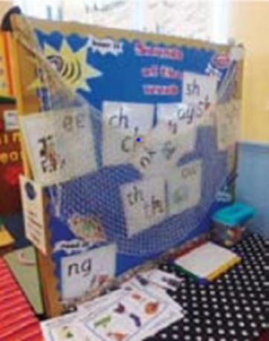

Phonics in Year 1
Children will continue with phonics lessons throughout Year 1
We teach children to read using the systematic phonics programme Read Write Inc. Phonics.
This is a complete phonics programme which helps all children learn to read fluently and at speed so they can focus on developing their skills in comprehension, vocabulary and spelling.
For further information please follow this link Phonics - Thameside Primary School
In June all children will undertake the year 1 phonics screening.

Slide 9

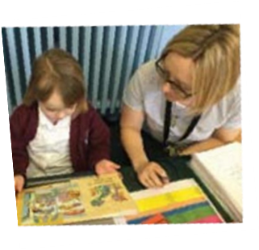
Reading in Year 1
Reading books and reading record :
Your child will bring home a reading record, phonics book and a bookbag book which should be kept in their book bag for protection.
Phonics books and bookbag books should be changed weekly.
Throughout Key Stage 1, you should read with your child for a minimum of 10 minutes each day. Please comment or simply sign the reading record to confirm that your child has read with you.
Children will also receive a weekly phonics e-book, which is set through the Oxford Owl website. Your child will have their own log in and password. Please practice this book each week, as it will reinforce their phonics learning.

Slide 10
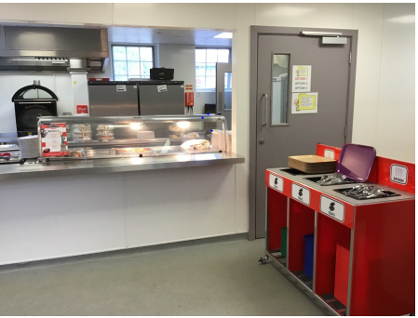
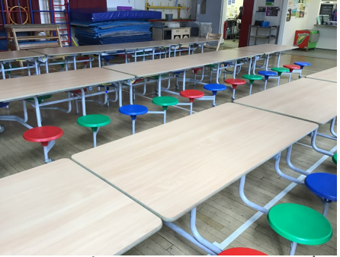
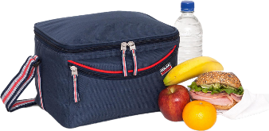
The school day
Water – please bring in a named water bottle
Snack – a piece of fruit will be provided
Lunchtime
  School dinner
    ParentPay
    Ordered before 9am
  Packed lunch
    Healthy and balanced
    No nuts

Slide 11




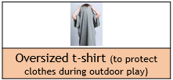
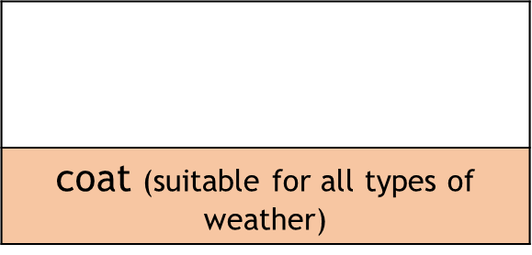


What to bring to school everyday
book bag or small rucksack | water bottle | lunch box/bag (if applicable)
A hat, scarf and gloves are needed for colder days
A sun hat is needed for warmer days (please apply sun block at home)
All clothes and other items that your child brings to school need to be named

Slide 12

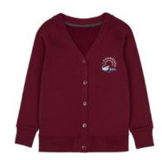

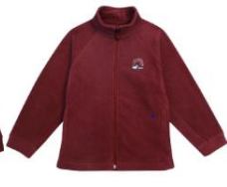



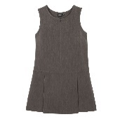

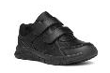
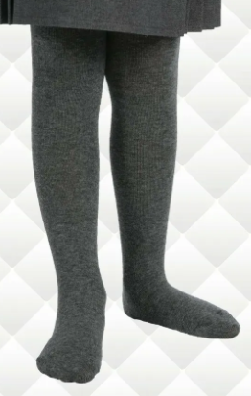
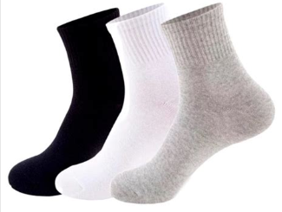
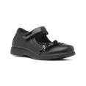
School Uniform
White polo shirt | jumper/cardigan | School fleece | Grey trousers/ shorts
Grey skirt/ pinafore | summer dress | Black school shoes | Grey tights or plain white/black/grey socks
Our school colour is burgundy and is teamed with white and grey
You can purchase items of clothing with the school logo on from Thameside Primary School (mandsyourschooluniform.com)
Please ensure your child is dressed suitably for the weather – we are outside at much as possible
All clothes and other items that your child brings to school need to be named

Slide 13

PE Kit
Children should bring appropriate PE kit to school on a Monday and take it home on a Friday.
PE days may move
Suitable kit for PE lessons outside
Children with long hair should have it tied back on PE day
During PE children must either remove stud earrings or, if unable to, cover with tape.

Slide 14

Home and school working together to support learning
Homework
Knowledge organisers for history/geography and science will be sent home at the start of each unit of work. Please help your child by quizzing them, letting them quiz asking them to redraw diagrams or finding other fun ways to help them commit this information to their long term memory.
Once a term, we will set an Own work project related to our topic.
Once a week on the school newsletter there will be a question for you to discuss with your child to help support their learning
Oxford Owl e-books and quizzes
Every night
Read for at least 10 minutes
Number skills (number bonds…)
Having conversations about their learning.

Slide 15
Thank you!
We look forward to meeting you in the coming weeks..

