Slide 1

Welcome to Thameside Primary School
Induction for New Staff

Slide 2
School Address and contact details:
Address:
Thameside Primary School
Harley Road,
Caversham
Reading
RG4 8DB
Telephone: 0118 9375551
Email Office: admin@thameside.reading.sch.uk

Slide 3
School Opening hours
School is unlocked at 7.30am
School is locked at 7pm (Cleaners are onsite until this time)
If you are still on site later than your contracted working hours please ensure you inform Vicki Lucas, Business Manager or Richard Harvey, Caretaker if you are lone working on site.
School is closed on weekends.
During the holidays, the school is open on set days. A list of dates will be shared before each holiday to confirm when school will be accessible or speak to Vicki Lucas, School Business Manager.

Slide 4
School Information
School main email account: admin@thameside.reading.sch.uk
Tel: 0118 937 5551
Website: https://www.thameside.reading.sch.uk/
Admission and Term dates: https://www.thameside.reading.sch.uk/page/?title=Admissions+%26amp%3B+Term+Dates&pid=192
Meet our Governors: https://www.thameside.reading.sch.uk/page/?title=Governors&pid=205

Slide 5
School Contacts
Mrs Sophie Greenaway – head@thameside.reading.sch.uk
Mrs Ingrid Burton- deputy@thameside.reading.sch.uk
Miss Christina Calvert- assistanthead@thameside.reading.sch.uk
Mrs Charlotte Harkins- (Asst Head of Inclusion) - Inclusion@thameside.reading.sch.uk
Miss Vicki Lucas- (Business Manager) sbm@thameside.reading.sch.uk
Mr Richard Harvey- caretaker@thameside.reading.sch.uk
Office Staff:
Mrs Emma McAdden- Evans – Office Administrator (admin@thameside.reading.sch.uk)
Miss Becca Clark – Finance/ Office Administrator (finance@thameside.reading.sch.uk)

Slide 6
Before you start….
Read through the Staff Handbook – this will be emailed to you with your offer of employment.
If you can, it would be great if you can complete the following online training at home
https://safeguarding.thekeysupport.com/elearning/
Keeping Children Safe in Education (KCSIE) –updated September each yeat
Safeguarding and child protection essentials
Online Safety
Child on Child abuse
There will be further training you are required to complete on commencement via TES Develop.

Slide 7
On your first day….
Collect a Door Fob from the school office
Wear this to school everyday, as it will give you access around certain doors in the building. If you forget your fob, you may borrow a temporary fob that you must return at the end of the day.
If you lose your fob you must alert Vicki Lucas, School Business Manager immediately so that it can be deactivated. A new fob will be charged to you at £5.
Be issued with a locker to store personal belongings
Have your photograph taken for your school ID pass
Have a tour round the building including Fire and Lockdown protocols

Slide 8

Work email address
You will be set up with a work email address. You should access this daily to collect important information shared with the whole school including the Weekly Head’s briefing.
You need to log in on a school device for the first time for it to sync your account otherwise it will not work on portal or home devices.
Example format/username: jbloggs@thameside.reading.sch.uk
(first initial of your forename, followed by your surname)
Access your work email from any device via the school’s website
https://www.thamesideprimary.co.uk/
Go to:
Contact Us
Staff Email Access

Slide 9

Accessing monthly Payslips/P60
You will not receive paper payslips- they are posted on iTrent the employee self service portal for you to access/print.
iTrent ESS (to view payslips etc) - You have to log in to Itrent with your personal email address and set up your multi authentication factor.
It is best to choose option 2 - text message to complete the authentication process.
Please see below the current link to iTrent.
Go to: https://reabcli.webitrent.com/reabcli_ess
Click on register and follow instructions on screen.
Email Payslip Setup - set up instructions
iTrent ESS allows for Employees to setup to receive their monthly payslips and annual P60s to their personal email account. A payslip is received in the form of an attachment each month, which requires a password to be setup. You don't then have to login to itrent every month to check.
Once logged in, go to little person icon in far top right-hand corner of homepage screen, then click on 'Settings' then click on ‘E-form preferences’. Complete the form with the email address you want to send your payslips to and then put a tick in the 'Payslips and P60' boxes as in images below in next slide.
Email Vicki Lucas sbm@thameside.reading.sch.uk if you have any problems logging in if you have never logged on before.
Page 1

Slide 10
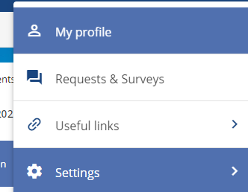
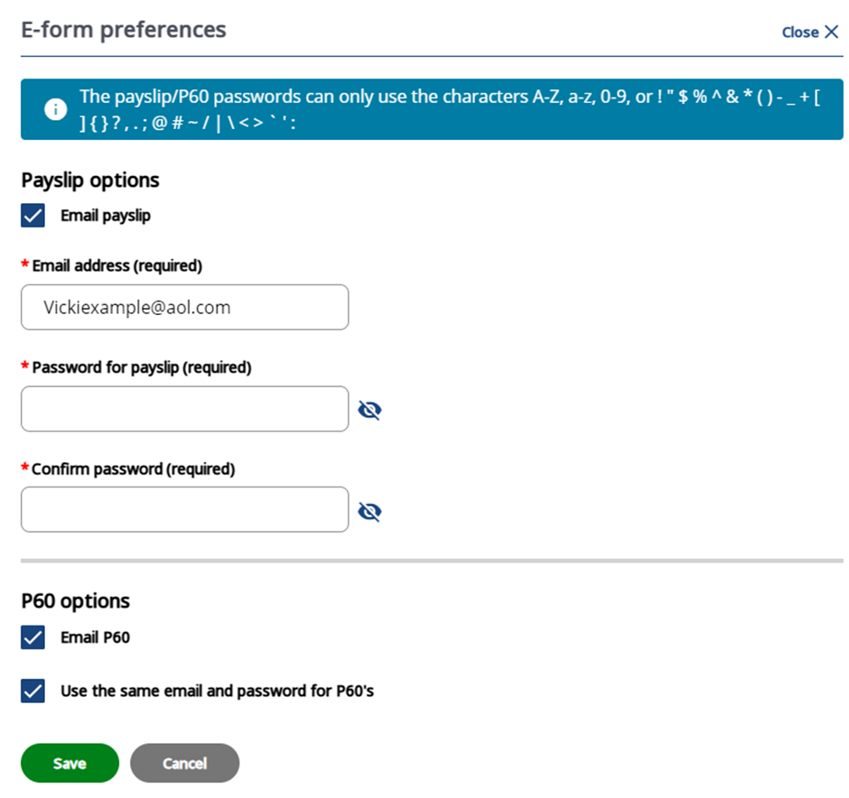
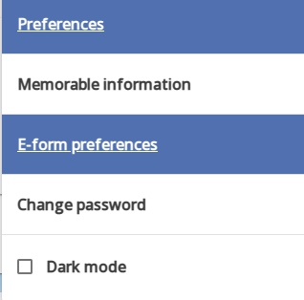
Page 2

Slide 11
Reporting Absence
Staff Absence
If you are absent from work through sickness please use the following procedure to ensure that cover can be arranged and paperwork completed.
On or before the day of absence:
Notify the school office as early as possible by calling the office line 0118 937 5551. If there is no reply leave a message on the answer phone. The employee should provide a clear reason for the absence and the likely duration.
The employee must also notify the following;
teachers must also notify either the Head (07957 348 836) or Deputy as early as possible so that cover can be coordinated prior to the school day commencing
teaching assistants must also notify class teacher via call or text
lunchtime support staff must also notify Miss Lucas, School Business Manager (07787 803 251)
admin and premises staff must notify Miss Lucas, School Business Manager (07787 803 251)
The employee should also be prepared to discuss briefly any consequences of his/her absence and what work needs to be covered. The reporting of updates after the first day of absence will be subject to agreement between the manager and the employee depending on the reason for the absence and the likely duration.
Notification of sickness absence should ideally be via telephone, rather than text message, email or social media. In exceptional circumstances where the employee is unable to telephone (for example, because of hospitalisation), another person such as a friend or relative can contact the School on his/her behalf.
See staff handbook for full absence procedures. From page 20 onwards.

Slide 12
Staff Handbook
Please find time to read the staff handbook in full as it will give you a comprehensive overview of the school, staffing structure, our school aims and values, procedures and curriculum information to help you start your journey at Thameside.
To view whole Staff handbook login into PC and go to shared: Common drive / General/ P/ 2026-27 Whole School Organisation/ Teacher Handbook 26-27
Ask for help if you cannot find this.
Other useful information about who does what please visit on the shared Common folder:
Go to the ‘Welcome and Where to Find Things 26 27’ document.

